Slide 1

Framing News Headline from keyterms using NLP
RSS Harika - 20VV1A0541
Venkat Ala - 20VV1A0503
Ch Vignan - 20VV1A0510
Ch Mahesh - 21VV5A0568
Project Guide
Dr. R Rajeswara Rao

Slide 2

Table of
CONTENTS
01
02
03
04
Problem Statement
Proposed objectives
Methodology
Experimentation setup
05
06
07
08
Stages of Experimentation work
Contd..stages of experimentation work
Literature survey
Solutions to Limitations

Slide 3

Problem
Creating an NLP-based system to generate informative news headlines by extracting key terms and candidate phrases, aiming to improve information retrieval and reader comprehension.
STATEMENT

Slide 4

Optimizing Key Term and Candidate Phrase Extraction
Proposed
Implementing advanced NLP techniques for extracting key terms and candidate phrases, utilizing features like Term Frequency, Numerical Data, Term Count, and a word dictionary tailored for different news categories.
OBJECTIVES
Effective Parsing of Leading Sentences
Employing Natural Language Processing (NLP) parsing techniques to generate parse trees for leading sentences, identifying the most informative content to be included in news headlines.
Headline Construction via Compression Algorithm
Utilizing a sentence compression algorithm to condense parsed sentences, forming compressed sentences that serve as potential headlines, followed by post-processing steps for improved syntax, tense, and grammar.

Slide 5
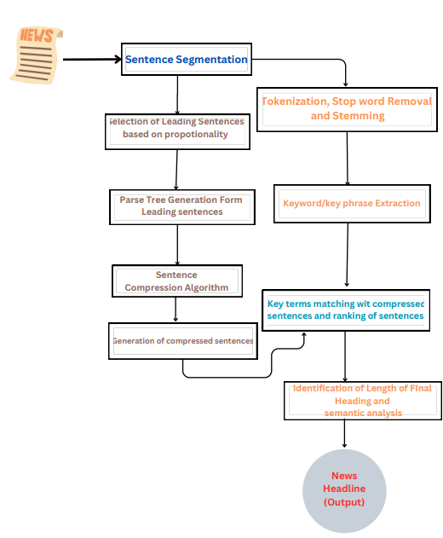
Methodology

Slide 6

Experimentation Setup
01
Programming Languages
02
NLP Libraries and Tools
Python: Primary language for implementing NLP algorithms and handling data processing tasks.
NLTK (Natural Language Toolkit): A powerful library for working with human language data. Components such as tokenizers, stemmers, and parsers from NLTK are employed.
Stanford Parser: Used for efficient parsing of leading sentences, generating parse trees that capture syntactic structures.
KEA (Keyphrase Extraction Algorithm): An algorithm specifically designed for extracting keyphrases from text. Applied for identifying and extracting candidate phrases.
03
Text Preprocessing
Tokenization: NLTK's tokenization functions are employed to break down text into individual words or phrases.
Stemming: Reducing words to their root form using NLTK's stemming algorithms.

Slide 7
STAGES OF EXPERIMENTATION WORK
DATA COLLECTION AND
PREPROCESSING
KEY TERM AND KEYPHRASE EXTRACTION
PARSING OF LEADING SENTENCES
COMPRESSED SENTENCE GENERATION
MATCHING AND RANKING
Collection of news articles and relevant datasets.
Preprocessing of text data, including tasks like removing irrelevant information, handling noise, and ensuring consistency.
Implementation of algorithms for extracting key terms and keyphrases.
Integration of features like Term Frequency, Numerical Data, and Temporal Data for effective extraction.
Implementation of parsing techniques, utilizing Stanford Parser to generate parse trees for leading sentences.
Development of a compression algorithm to form concise yet informative compressed sentences.
Iterative steps to remove unwanted elements and achieve the desired headline length.
Matching extracted key terms with compressed sentences.
Ranking of compressed sentences based on the number of matched keywords.

Slide 8
STAGES OF EXPERIMENTATION WORK
POST-PROCESSING
EVALUATION AND METRICS CALCULATION
DOCUMENTATION AND KNOWLEDGE DISSEMINATION
CONTINUOUS IMPROVEMENT AND FUTURE RESEARCH
Implementing post-processing steps to refine the selected headline.
Corrections for syntax, tense, and grammar to enhance the quality of the generated headline.
Calculation of precision, recall, and F1 score to quantitatively assess the system's effectiveness.
Comparative analysis with existing methods.
Detailed documentation of implemented algorithms, methodologies, and results.
Presentation of findings through research papers, presentations, and other dissemination channels.
Incorporation of feedback for continuous improvement.
Identification of areas for future research in NLP and headline generation.

Slide 9
Literature Survey
Research Paper 1:
Framing News Headline from Key Terms Using NL
In this papers, news headline is formed by using key terms and candidate phrases which are retrieved from input news article along with Natural Language Processing (NLP) techniques. Candidate phrases are extracted from input news article by using Key phrase Extraction Algorithm (KEA). The word dictionary for various kinds of news articles along with some more techniques of keyword extraction are used as criteria for selecting keywords. Parsing technique and sentence compression algorithm are used for construction of proper news headline from leading sentences. Headline gives the brief idea of lengthy news article. The main aim is to construct headline from key terms for saving the interpretation and reading time of reader.
Limitations
The compression of these leading sentences, a process that relies on user input regarding the desired length of the headline
The selection of number of leading sentences is fixed with a constant which is not so reliable in real world scenarios.

Slide 10
Research Paper 2:
Construction of News Headline from Detailed News Article
The extractive and abstractive approaches are conventionally used for news headline generation. In this paper, a combinational approach is used for headline construction by using keywords/keyphrases along with parsing technique of Natural Language Processing (NLP). The Keyphrase Extraction Algorithm (KEA) is used to extract key phrases from input news text. Respective news domain word thesaurus and some other approaches are used for retrieving keywords from news text. Proper headline syntax can be constructed by using parsing technique. Headline is useful to reduce the reading and interpretation time for getting the complete idea of entire news article. The objective is to save reader’s time and effort in finding the useful information in a detail news article
Limitations
The first sentence of lead paragraph of news article contains 86.8% of the headline words [11]. The compression of leading sentence helps
for generating title for news stories.
For Key-phrase extraction TF-IDF algorithm is used which is not so accurate for Key phrase extraction in NLP

Slide 11
Research Paper 3:
Hedge Trimmer: A Parse-and-Trim Approach to Headline Generation
This paper presents Hedge Trimmer, a HEaDline GEneration system that creates a headline for a newspaper story using linguistically-motivated heuristics to guide the choice of a potential headline. We present feasibility tests used to establish the validity of an approach that constructs a headline by selecting words in order from a story. In addition, we describe experimental results that demonstrate the effectiveness of our linguistically-motivated approach over a HMM-based model, using both human evaluation and automatic metrics for comparing the two approaches.
Limitations
Iterative shortening of sentences
Sensitivity to Parsing Errors

Slide 12
Proposed Solutions
Solution 1:
To identify the final length of headline we aim to conduct a survey on BBC articles, leveraging statistical methodologies. The goal is to identify a universal metric that captures the essence of news articles and can be employed in our system for effective headline compression.
Solution 2:
We also want to select number of Leading sentences from paragraph using advanced mathematical concepts instead of fixing it to a constant value.
Section 3:
A sentence is identified as a leading sentence based on text-ranking algorithm.

Slide 13
Thank you

